Slide 1
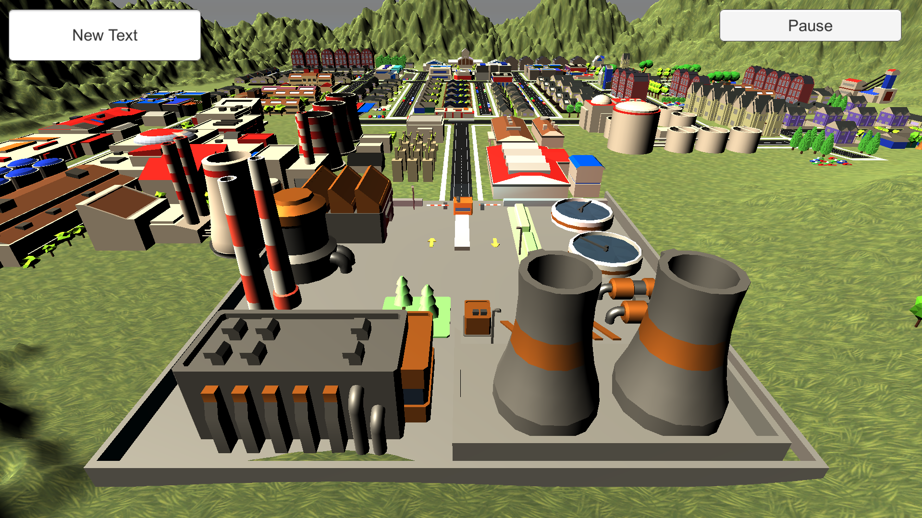
Player: Sam Score: 500
Close
Market
Installed
Building Type Production Pollution Price Purchase
0
Solarpanel farm Green 30 000 kWh 0 % 1000 $
0
Hydroelectric plant Green 275 000 kWh 0 % 10000 $
1
Nuclear Powerplant Gray 1000 000 kWh 5 % 25000 $
Buy
1200
$ 50000
☹ ☺

